Slide 1


Bigfoot sightings: Learning to create Shiny modules by turning an existing app modular
- Deepsha Menghani

Slide 2
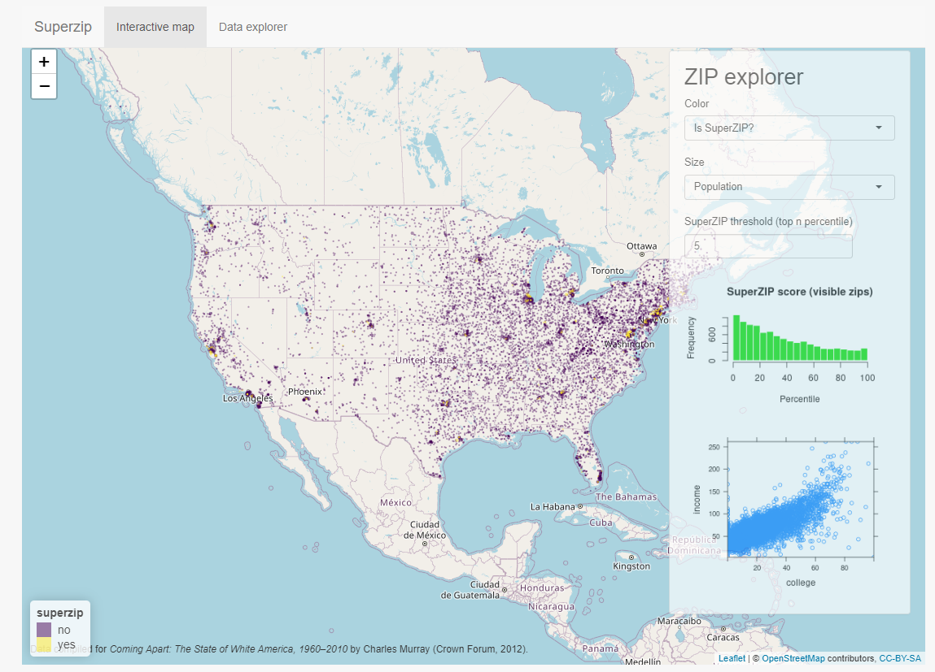
Shiny is a framework for building web applications using R and Python.

Slide 3
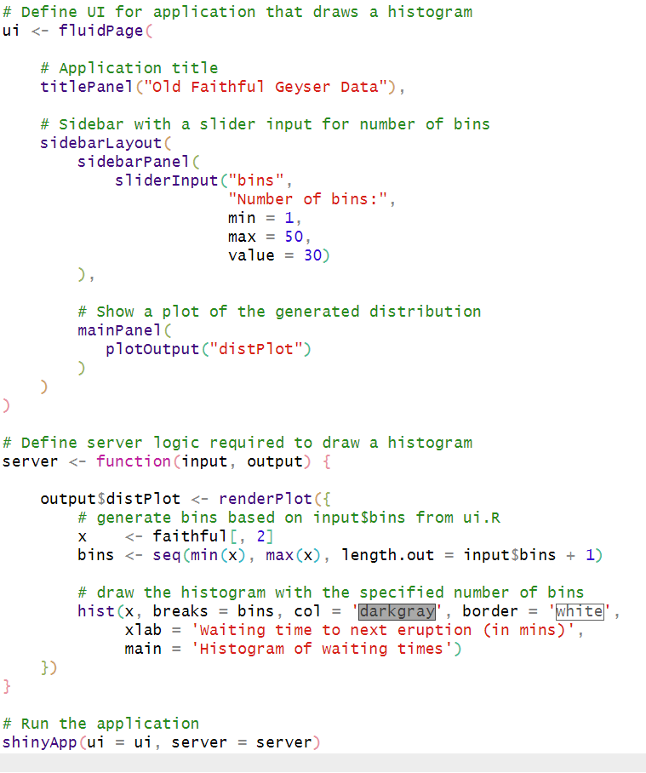
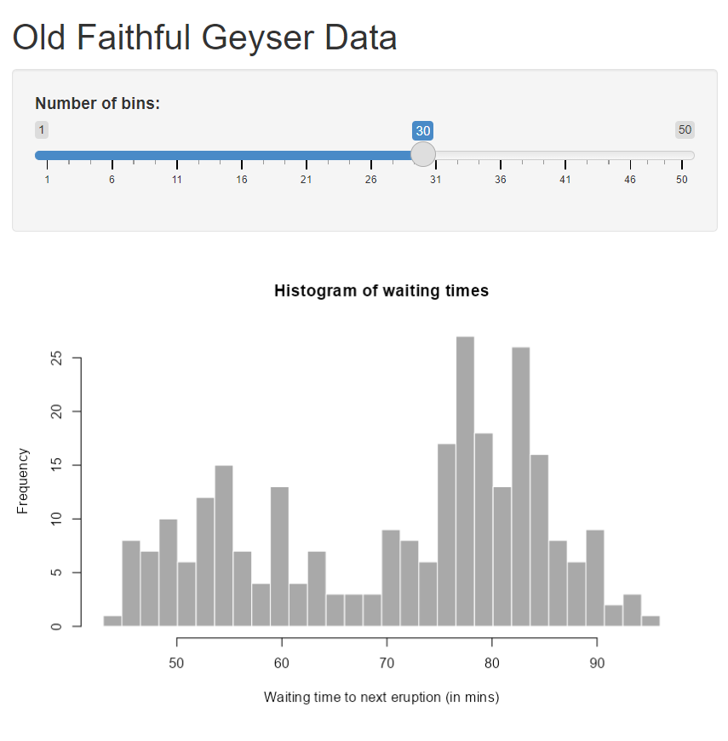
Learning Shiny…. A simple app.R file

Slide 4
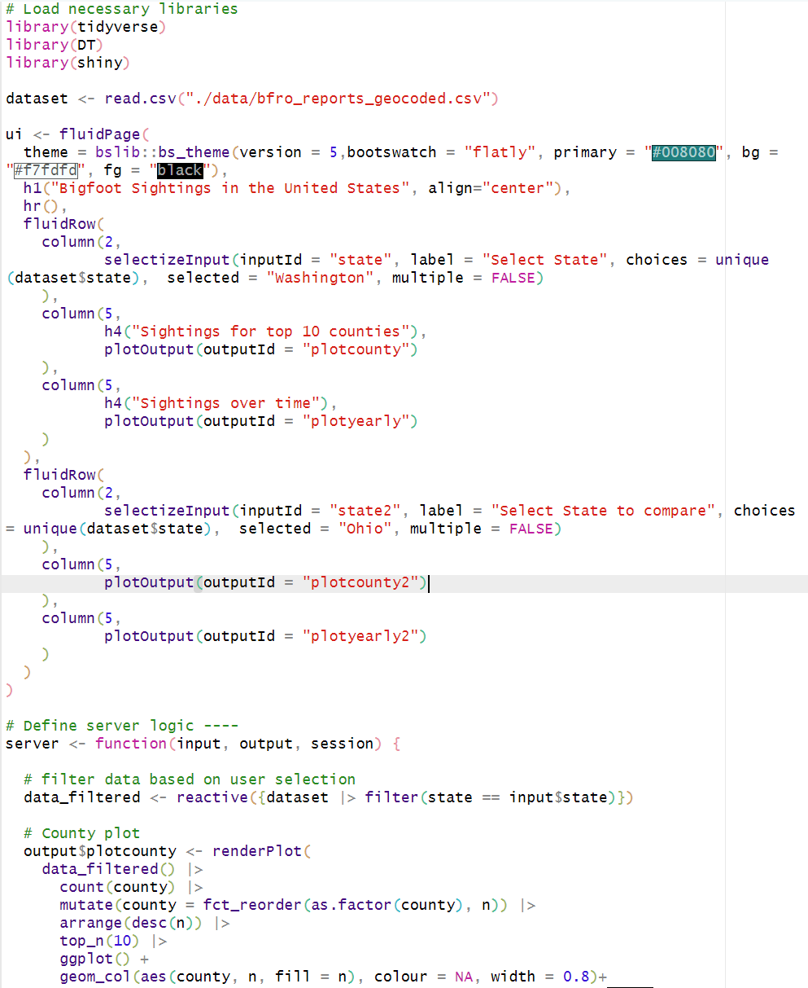
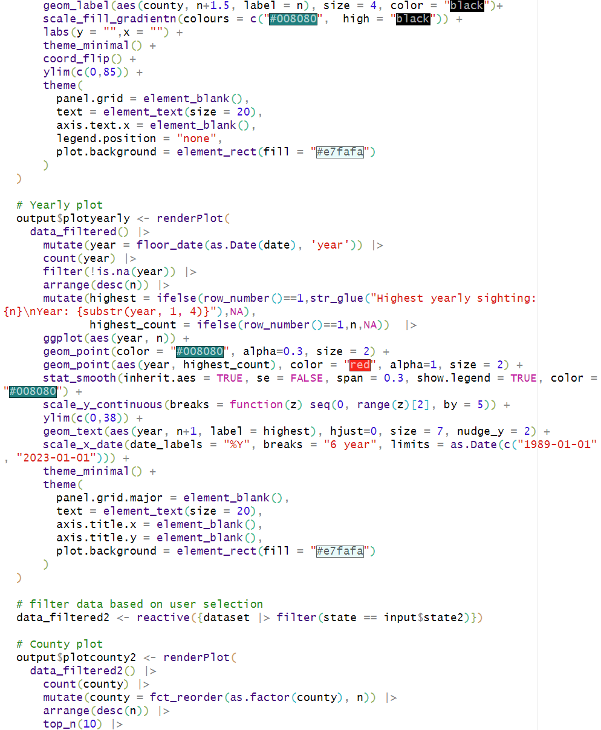
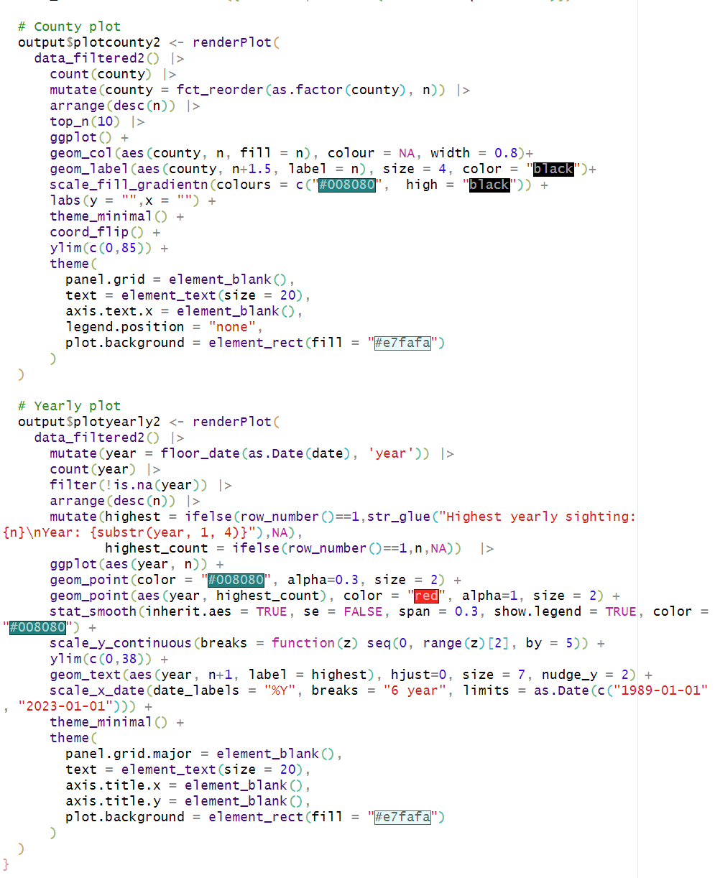
Building Shiny…. A much larger app.R file

Slide 5

The challenges with a monolith app.R file
Difficult to keep track of components
Challenging to debug if something fails
Harder for someone new to learn and contribute
Tedious to reuse its elements within itself and other applications

Slide 6
Enter Shiny modules… A reusable piece of Shiny code written as a function
Functions
Shiny

Slide 7
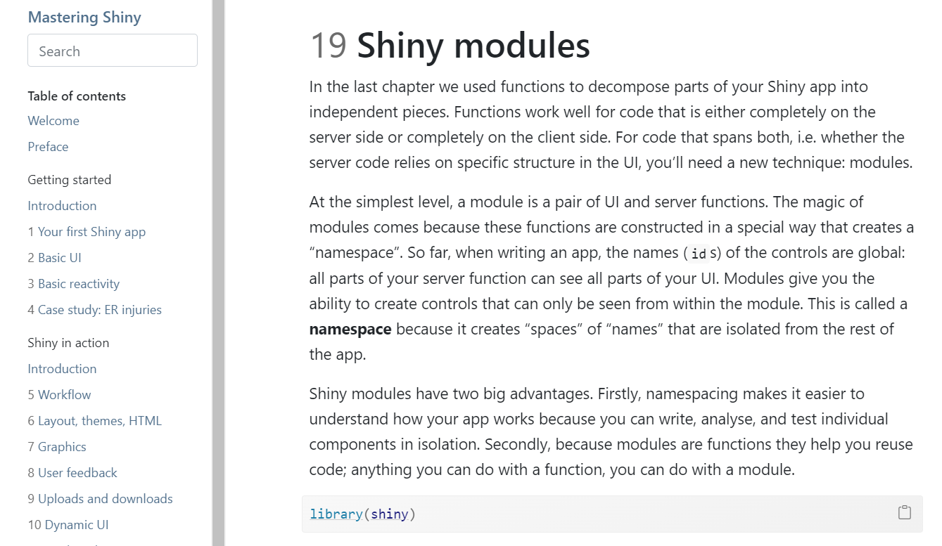
Superpower of Shiny and R functions combined

Slide 8
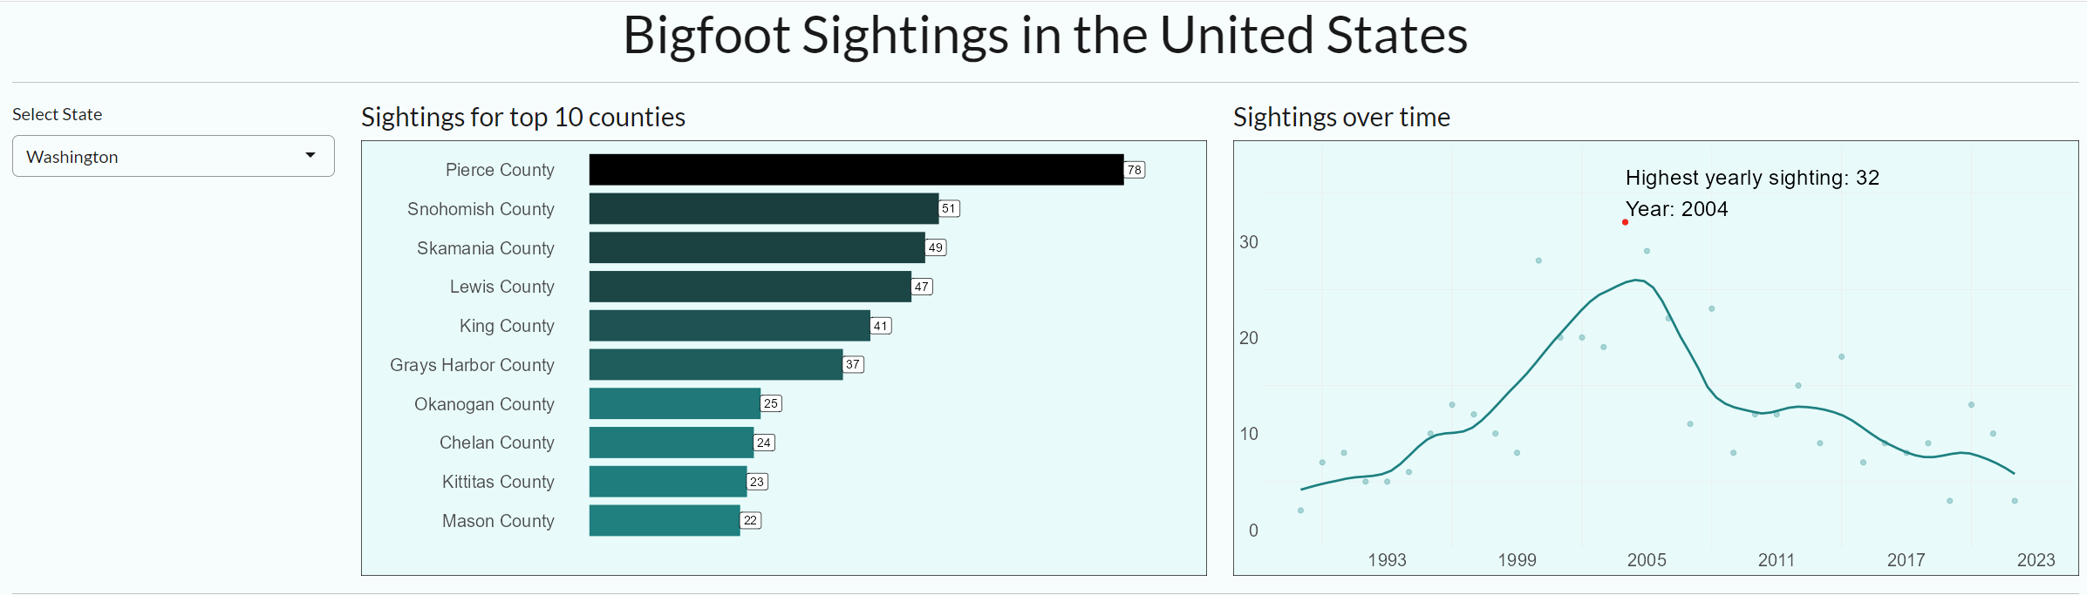
Let’s learn to write modules with a Shiny application

Slide 9
Step 1 : Decompose your application components

Slide 10
Step 1 : Decompose your application components
Input for
filtering data
County plot
(on filtered data)
Yearly plot
(on filtered data)

Slide 11
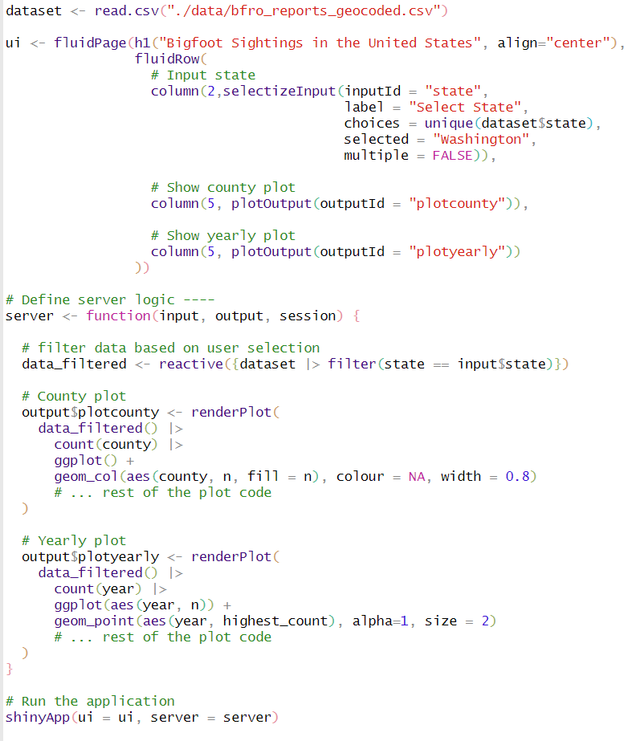
Main app.R file
3 ui elements
3 server elements

Slide 12
Main app.R file
3 ui elements
3 server elements

Slide 13
Main app.R file
3 ui elements
3 server elements

Slide 14
Main app.R file
3 ui elements
3 server elements

Slide 15
Step 2 : Create modules (baby shiny apps) for the distributed components
Module 1: Module_input.R
Ui: Create state input ui
Server: Filter data based on state input
Module 2: Module_countyplot.R
Ui: Create county plot ui
Server: Generate the county plot with ggplot code
Module 3: Module_yearlyplot.R
Ui: Create yearly plot ui
Server: Generate the yearly plot with ggplot code

Slide 16
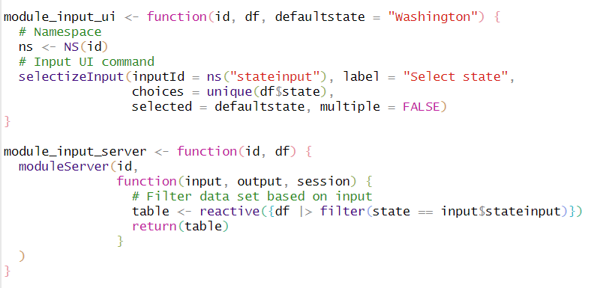
Original app.R file
Module 1: Module_input.R

Slide 17
Original app.R file
Module 1: Module_input.R
ui and server components are written as two separate modules, just like a shiny app.

Slide 18
Original app.R file
Module 1: Module_input.R
In this module we want to ask user to input “state” and then filter data based on the user input

Slide 19
Original app.R file
Module 1: Module_input.R
We create the ui and server as functions that can be called from the main app.R file

Slide 20
Original app.R file
Module 1: Module_input.R
ID serves as a unique identifier for each instance of the module within the application, allowing multiple instances of the same module to coexist and be independently controlled.

Slide 21
Original app.R file
Module 1: Module_input.R
ID serves as a unique identifier for each instance of the module within the application, allowing multiple instances of the same module to coexist and be independently controlled.
ID is instantiated when the module function is called from the main app. Each ui and server call have the same unique id connecting the two.

Slide 22
Original app.R file
Module 1: Module_input.R
A namespace is like a separate room that contains all the functions and variables specific to that module, preventing naming conflicts and keeping things organized

Slide 23
Original app.R file
Module 1: Module_input.R
A namespace is like a separate room that contains all the functions and variables specific to that module, preventing naming conflicts and keeping things organized
Each input name is encapsulated in ns() to ensure that it is properly namespaced and avoid conflicts with input names from other module calls in the main application

Slide 24
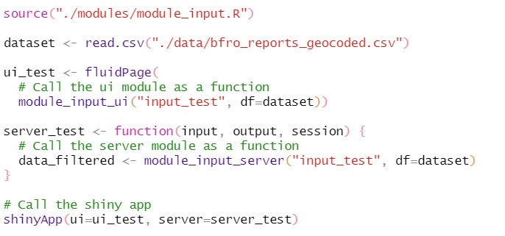
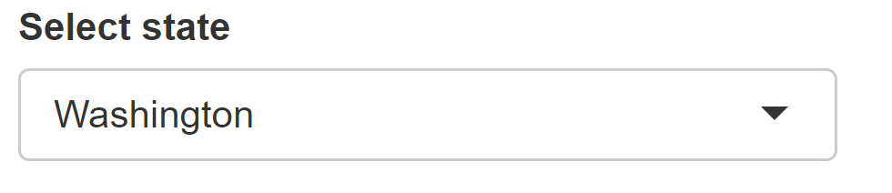
Step 3: Test your module
Module 1: Module_input.R
Call the module function from the main app.R file
Test app.R
Shiny App output

Slide 25
Step 3: Test your module
Module 1: Module_input.R
Call the module function from the main app.R file
Test app.R
Shiny App output
Source your module_input.R file

Slide 26
Step 3: Test your module
Module 1: Module_input.R
Call the module function from the main app.R file
Test app.R
Shiny App output
Call the ui module and server module functions from the main app ui and server

Slide 27
Step 3: Test your module
Module 1: Module_input.R
Call the module function from the main app.R file
Test app.R
Shiny App output
Shiny app is created
Call the shiny app command

Slide 28
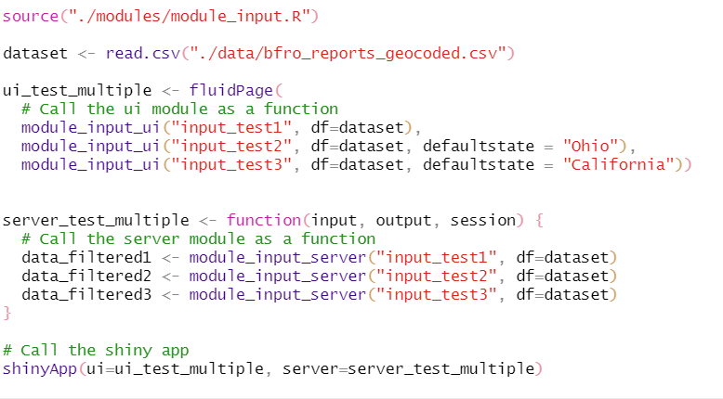
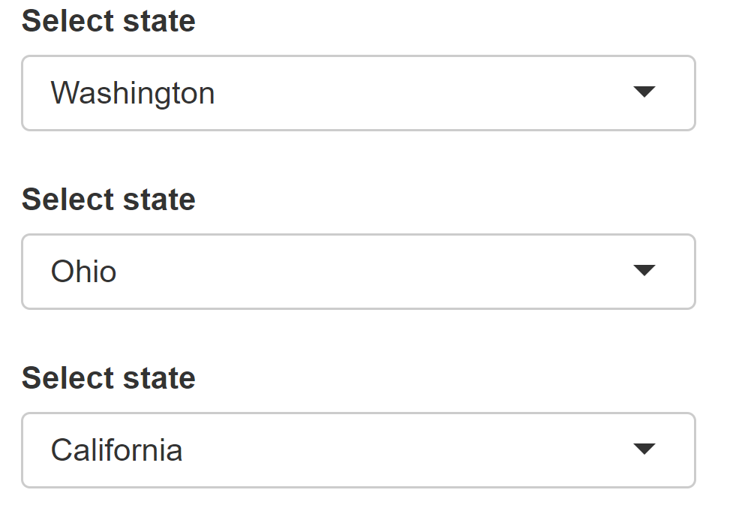
Handling multiple module calls
Module 1: Module_input.R
Call the module function from the main app.R file
multiple times with separate unique IDs – it is that simple!!
Test app.R
Shiny App output

Slide 29
Handling multiple module calls
Module 1: Module_input.R
Call the module function from the main app.R file
multiple times with separate unique IDs – it is that simple!!
Test app.R
Shiny App output

Slide 30
Step 4: Replicate modularization for other decomposed components
Module 1: Module_input.R
Ui: Create state input ui
Server: Filter data based on state input
Module 2: Module_countyplot.R
Ui: Create county plot ui
Server: Generate the county plot with ggplot code
Module 3: Module_yearlyplot.R
Ui: Create yearly plot ui
Server: Generate the yearly plot with ggplot code

Slide 31
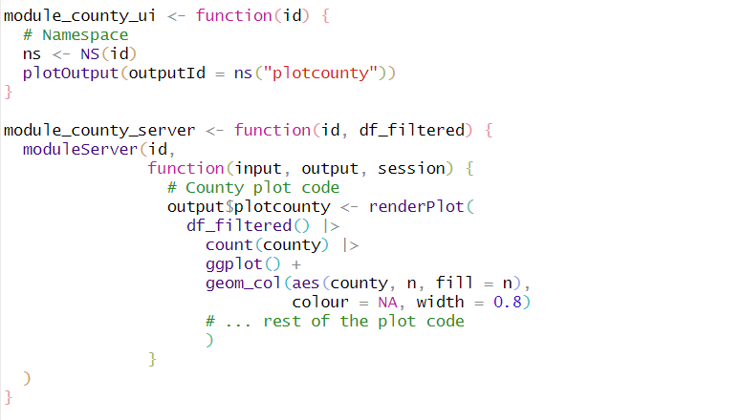
Original app.R file
Module 2: Module_countyplot.R

Slide 32
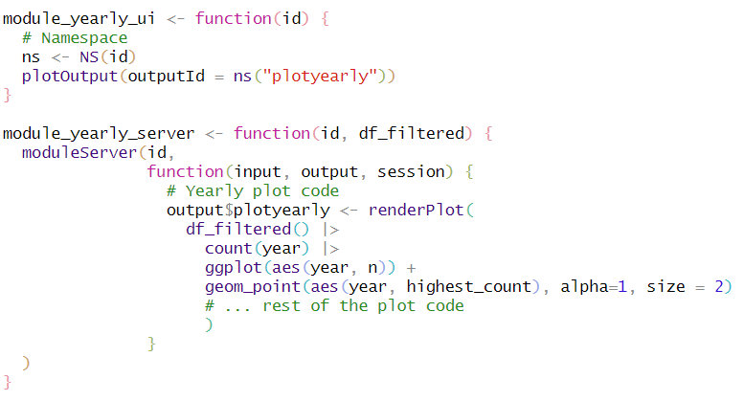
Original app.R file
Module 3: Module_yearlyplot.R

Slide 33
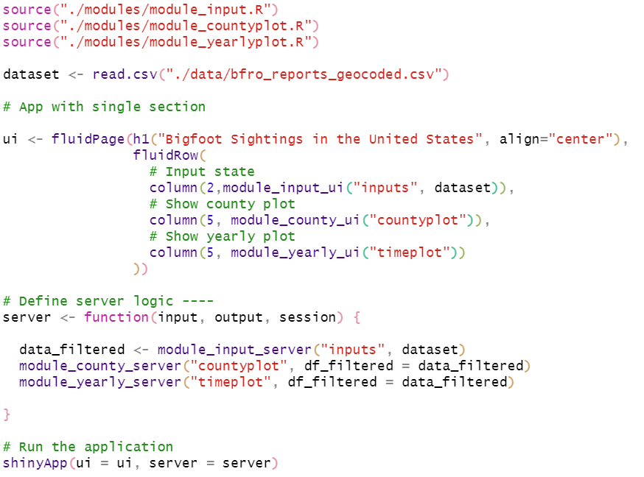
Original app.R file
Step 5: Call modules from the main app.R file
Updated app.R file

Slide 34
Original app.R file
Source the module files
Updated app.R file

Slide 35
Original app.R file
Call state input ui and server modules with “same” id
Updated app.R file

Slide 36
Original app.R file
Similarly, call country plot ui and server modules
Updated app.R file

Slide 37
Original app.R file
Similarly, call yearly plot ui and server modules
Updated app.R file

Slide 38
Original app.R file
Run the shiny app
Updated app.R file
app.R is so clean and simple to read!!!

Slide 39
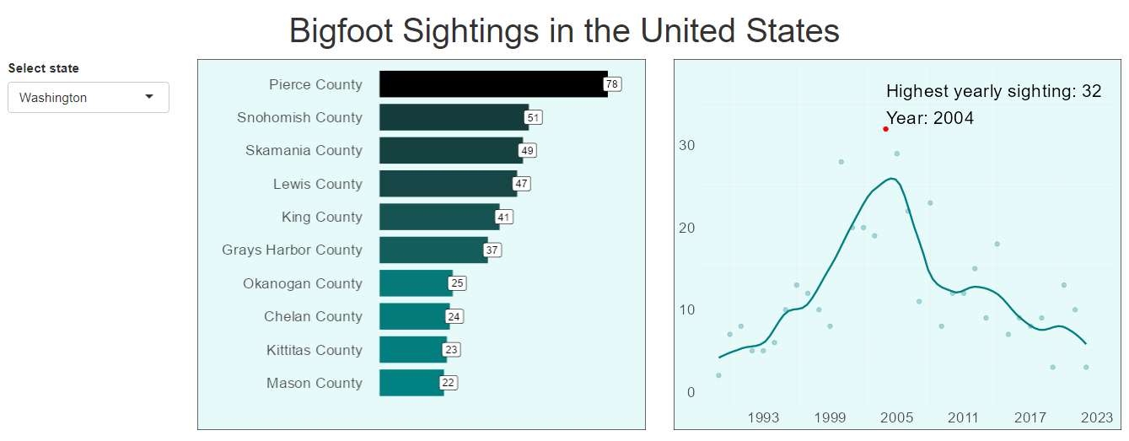
Shiny output

Slide 40
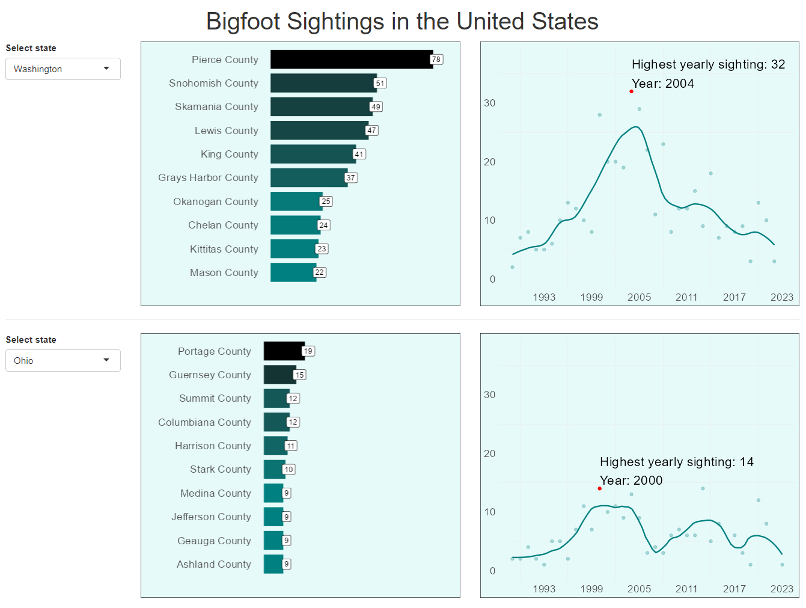
Now, let’s replicate input and output plots for two state comparison
Like this ->

Slide 41
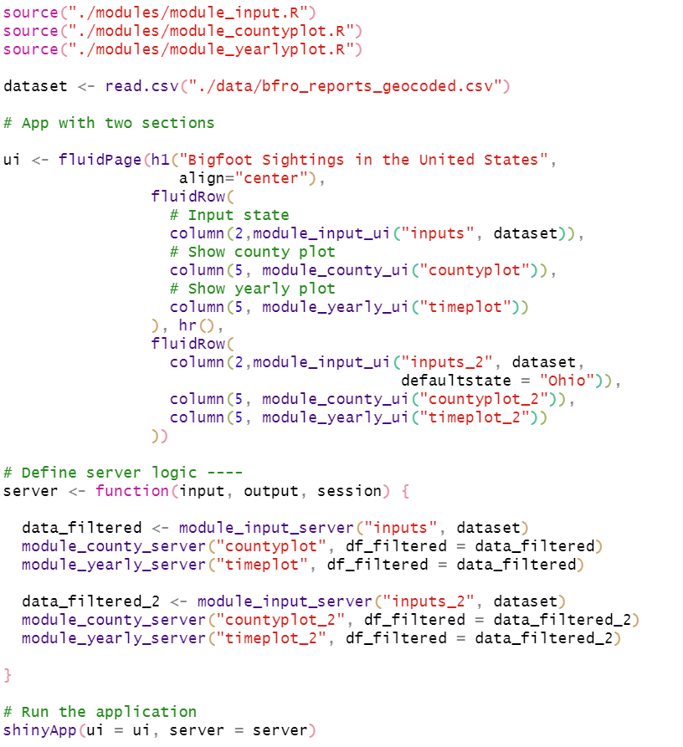
Updated app.R file –
single module, multiple calls
Original app.R file

Slide 42
NOTE: Unique ids amongst each module calls
Original app.R file

Slide 43
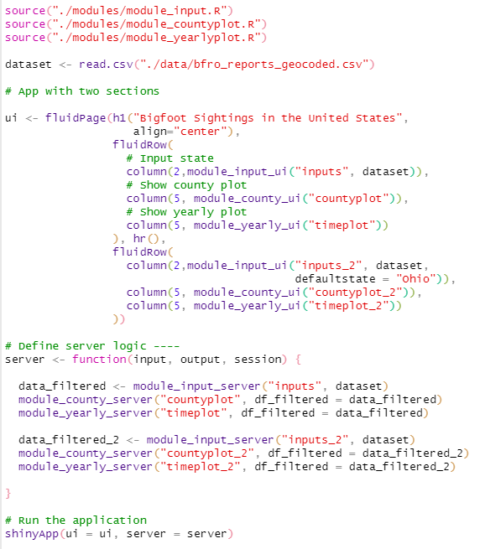
Updated app.R file –
single module, multiple calls
Shiny App output

Slide 44
Original app.R
ui
ui Input
ui Plot display
Server
Server data filter
Server Plot

Slide 45
Module_input.R
Original app.R
Module_input_ui
ui Input
ui
ui Input
ui Plot display
Module_input_server
Server data filter
Module_plot.R
Server
Server data filter
Server Plot
Module_plot_ui
ui Plot display
Module_plot_server
Server Plot

Slide 46
Module_input.R
Original app.R
Modularized app.R
Module_input_ui
ui Input
ui
ui Input
ui Plot display
ui
Module_input_server
Server data filter
Module_input_ui
Module_plot_ui
Module_plot.R
Server
Server data filter
Server Plot
Server
Module_plot_ui
ui Plot display
Module_input_server
Module_plot_server
Module_plot_server
Server Plot

Slide 47
The challenges with a monolith app.R file
Difficult to keep track of components
Challenging to debug if something fails
Harder for someone new to learn and contribute
Tedious to reuse its elements within itself and other applications

Slide 48

With a modular approach
Easy to keep track of components
Single location to debug if something fails
Structured cleanly for someone new to learn and contribute
Element usability within itself and other applications

Slide 49
Next steps
If you are yet to learn shiny, start with modular approach
If you learned it the monolith way, start with converting an existing app modular
Check out Mastering Shiny book by Hadley Wickham
Check out the Github repo for modular bigfoot app

